Slide 1
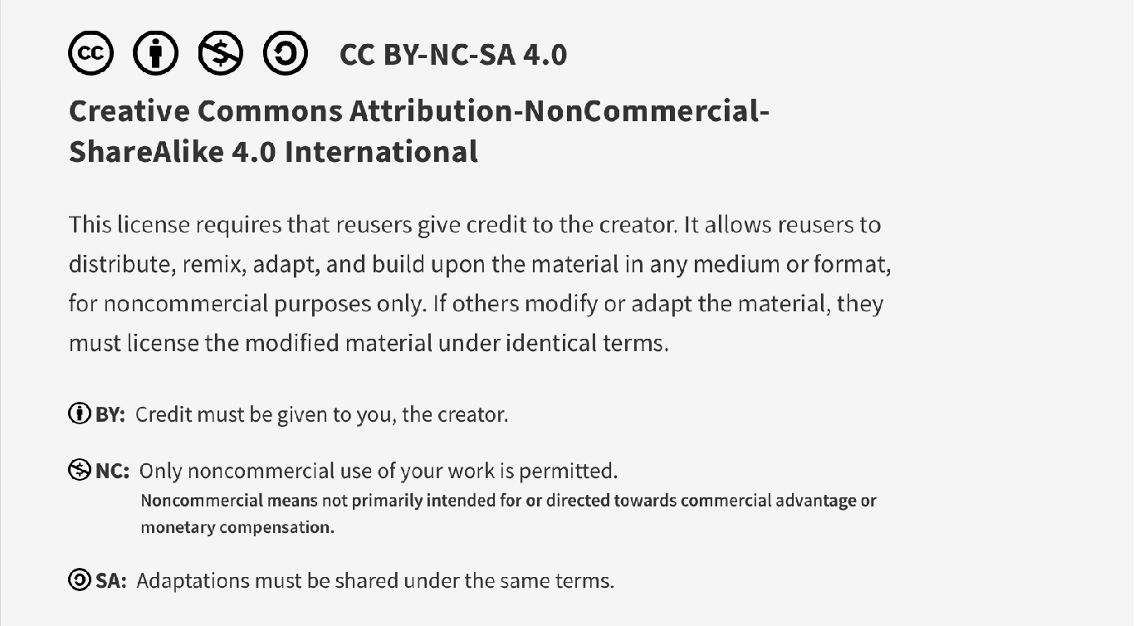
This work is licensed under CC BY-NC-SA 4.0. To view a copy of this license, visit: https://creativecommons.org/licenses/by-nc-sa/4.0/

Slide 2
Resource Stewardship Pre-Session Material
Lucie Filteau, MD, FRCPC
PGY 2-4 Academic half day
QPS Series

Slide 3
Learning Objectives
To recognize the wide variety of resources that can be wasted and identify specific examples
To identify the harm associated with overuse
To discuss possible strategies to improve resource stewardship at a personal and system level
To become aware of key educational resources and organizations that promote resource stewardship

Slide 4




Resource Stewardship Resources
This ppt is adapted from material found on the Royal College and Choosing Wisely Canada websites (accessed July 2023)

Slide 5

Resource Stewardship
Care that uses the most efficient means to effectively diagnose a condition and treat patients. It respects the need to use resources wisely and ensures that resources are equitably available and used judiciously.
All non-referenced images in this ppt are from Freepik (royalty and attribution free and authorized for non-commercial use)

Slide 6

Types of Resource Waste
Money, materials
Skills
Underutilization of skilled staff (e.g. AA’s)
Overly skilled staff used for lower level tasks
Time
Machine, staff and information downtime
Energy
Unnecessary/redundant tasks, unnecessary movement (of staff, materials, patients)
Supply/demand mismatches

Slide 7
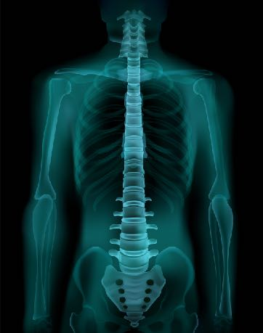


Classic Examples of Overuse in Medicine
Bloodwork
Preop blood tests for minor procedures in healthy patients
Imaging
Imaging for low back pain, minor head trauma
(in absence of red flag signs/symps)
Treatments
Antibiotic Rx for URTI’s, otitis media
Procedures
Knee arthroscopies for patients > 60 yrs with degenerative dz

Slide 8

Resource Stewardship ≠ Rationing!
“There is a misperception that resource stewardship and rationing care are one in the same. This is not true. Rationing is when health care providers decide who receives effective health care tests, treatments or procedures based on certain criteria, such as age. Resource stewardship is when health care providers do NOT provide care to patients which evidence shows is not effective. These decisions are made collaboratively with the patient. We need to give each patient the care that they need, but also consider what they don't need and avoid care that can cause harm.”
Dr Wendy Levinson
IHI Open School. Resource Stewardship in Medicine. Last retrieved July 31, 2017 from https://vimeo.com/93605940

Slide 9
Quality
Value =
Cost
Equity
Value of care can be improved by increasing quality and/or decreasing costs
Safety
Timeliness
Quality
Patient Centeredness
Efficiency
Effectiveness
Institute of Medicine (IOM). 2001. Crossing the Quality Chasm.
Crossing the Quality Chasm: A New Health System for the 21st Century. Washington, D.C: National Academy Press.

Slide 10
Quality
Value =
Direct Costs to Patients
Cost
Costs to consider go far beyond monetary costs
Opportunity Costs
Total Cost
Direct Costs to System
Downstream Costs and Harm

Slide 11


Harms of Overuse (Investigations/Tx’s)
Individual Patients
Physical (unnecessary pain,A/E’s, incidental findings)
Psychological (anxiety, fear)
Financial (e.g. missed time from work)
Health Care System
Pressure on providers
Increased wait times
Costs of wasted resources
Adapted from Brownlee et al. 2018 The Lancet, 390 , 10090, 156 – 168.

Slide 12

It’s in our hands!
80% of all healthcare costs are driven by physicians
Which pts are seen, how often
Which patients are hospitalized, for how long
Which tests are ordered
Which procedures are performed
Which medications are prescribed
These decisions are under our control = much opportunity for improvement initiatives to make a profound difference!
Berwick D and AD Hackbarth. Eliminating Waste in US Health Care. JAMA. 2012;307(14):1513-1516

Slide 13

Ethical Principles of Stewardship
Beneficence
Promote the well-being of others
Non-maleficence
Do no harm to others
Justice
Distribute resources fairly and equitably
Autonomy
Respects the individual’s rights to make own healthcare decisions

Slide 14
Choosing Wisely Canada
Choosing Wisely founded in 2012 (US)
Has spread to 25 countries
Choosing Wisely Canada (2014) = the national voice for reducing unnecessary tests and treatments in Canada
Clinician-led, identification of overused tests/Tx’s that are not supported by scientific evidence, can lead to harm
Recommendations developed by national specialty societies
Mobilizes healthcare providers and their organizations to adopt specialty-specific stewardship recommendations
Notes:
Funded by CMA, Health Canada, UofT (NO industry support)

Slide 15
Choosing Wisely Canada: STARS
STARS: Students and Trainees Advocating for Resource Stewardship
Engages trainees (students, residents) to engage in stewardship
Supports trainee-led initiatives to advance resource stewardship
Engages universities, professional organizations, regulatory bodies to embed stewardship in medical education

Slide 16

Barriers to Stewardship

Slide 17

Attending
Patient requests and expectations
Established habit, unfamiliar with new evidence
Time constraints
Defensive medicine
“More is better”
Pre-emptive ordering efficiency
Discomfort of “doing nothing”
Satisfying referral requests
Lack of behavioural feedback
Influence of industry
Financial incentives

Slide 18

Trainee (additional reasons)
To gain experience
Lack of confidence
Lack of feedback
Emphasis on harm of missing something over harm of test
Inadequate knowledge, poor understanding of evidence
Insufficient time
Faculty role modelling
Being directed to do so by supervisor
Desire to impress supervisor

Slide 19
What Can You Do (as an individual)?
Should I prescribe this treatment?
Should I order this test?
Have I considered the patient?

Slide 20

Should I order this test?
Will it help me make a diagnosis?
Will it result in a change in management?
Is the test redundant with existing information?
Is there a reasonable pre-test probability that it will be useful?
Does the benefit of the test outweigh the risk to the patient?
Adapted from SCARCE Clinical Criteria for Diagnostic Tests

Slide 21
Should I prescribe this treatment?
Is there evidence that the Tx is effective?
Will this treatment have a clinically significant impact on the patient?
Absolute Risk Reduction
Relative Risk Reduction

Slide 22
Risk Reduction
Absolute Risk Reduction (ARR)
Absolute difference between a treatment group’s event rate and the comparison group’s event rate
Relative Risk Reduction (RRR)
Treatment group’s event rate divided by the comparison group’s event rate
Beware: RRR often reported
Consider true clinical impact of reported effects

Slide 23
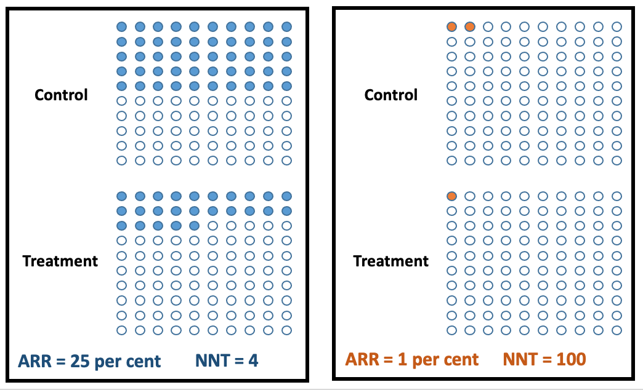
Treatment Effect
Both treatments offer a 50% relative risk reduction

Slide 24

Have I considered the patient?
Incorporate the patient’s values
“What is most important when it comes to your health?”
Include the patient in decision-making
“Which option seems like the best fit for you?”
Elicit patient’s concerns
“What are you most concerned about today?”

Slide 25

Empowering Patients
Questions patients should ask:
Do I really need this test?
Do I really need this treatment?
What are the downsides?
What happens if I do nothing?
Are there simpler, safer options?
Choosing Wisely Canada, 2017

Slide 26
Concrete actions trainees can take
Don’t order investigations that won’t change the patient’s management plan
Don’t order repeat lab tests on patients who are clinically stable
Don’t order IV route when an oral (po) option is appropriate and tolerated
Don’t order non-urgent investigations/procedures that will delay discharge of inpatients
Don’t order invasive studies if less invasive options are available and as effective
https://choosingwiselycanada.org

Slide 27
Concrete actions trainees can take
Don’t hesitate to ask for clarification on tests, treatments of procedures that you believe are unnecessary
Don’t miss the opportunity to initiate conversations with patients about whether a test, treatment of procedure is necessary
Don’t suggest ordering tests or performing procedures for the sole purpose of gaining personal clinical experience
Don’t order tests/treatments pre-emptively for the sole purpose of anticipating what your supervisor would want

Slide 28

Stewardship Interventions (larger scale)
Education
1:1 teaching, wider campaigns
Audit and feedback
Identify outliers (top/bottom performers)
Forced constraints
Decision rules
Development of protocols/guidelines
Automation
Defunding

Slide 29

November 2022 CIHI Progress Report
Overuse of Tests and Treatments in Canada
Looking at 12 selected tests/Tx’s over 5 years:
8/10 selected unnecessary tests/Tx’s declined by 10% or more
698 000 fewer unnecessary prescriptions and other Tx’s
115 000 fewer low value Xrays, CT scans, MRI’s, preop tests
13 000 fewer unnecessary surgical procedures
https://www.cihi.ca/sites/default/files/document/overuse-of-tests-and-treatments-in-canada-report-en.pdf

Slide 30
CIHI: Preop Testing for low-risk procedures
Tests: EKG, CXR, cardiac stress test, echocardiogram
Surgery: includes ophthalmic Sx (40%) and endoscopy (32%)
Wide variety in rates between provinces
E.g. Alta (down 37%) vs ON (down 15%) vs BC, NS (0%)
Decreased overall by 5% (from 25 to 20%)
35 000 fewer preop tests
Still MUCH room for improvement

Slide 31
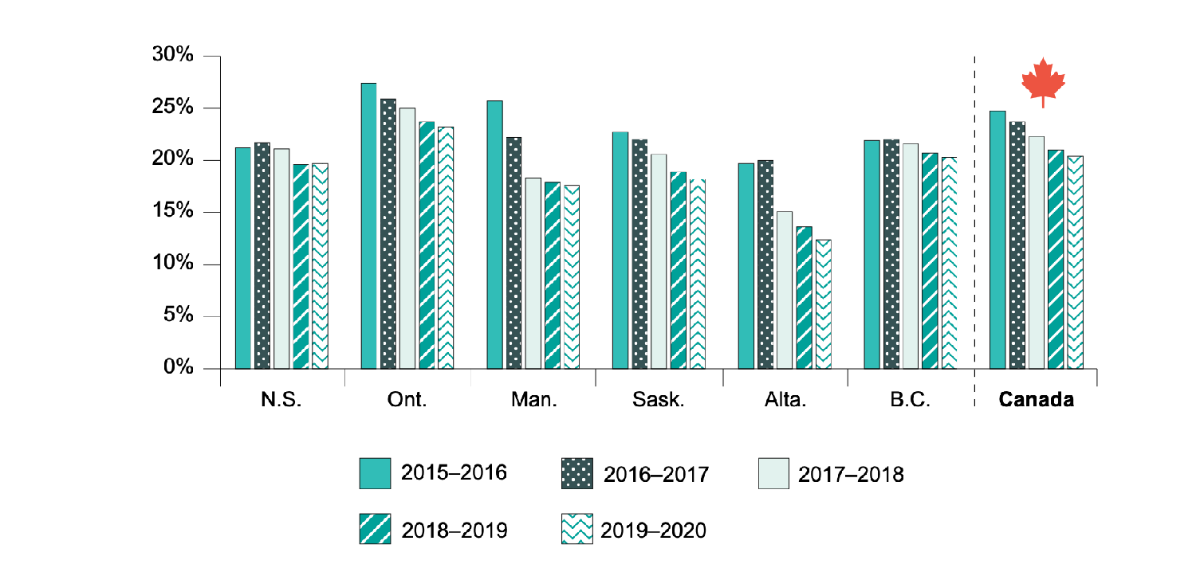
Preoperative testing in low-risk surgeries
National Physician Database, Discharge Abstract Database and National Ambulatory Care Reporting System,
2014–2015 to 2019–2020, Canadian Institute for Health Information.
Notes:
The preoperative testing rate was risk-adjusted for age, sex and surgery type.

Slide 32
Educational Intervention
Using Blood Wisely Program
Red cell transfusion in hospitalized patients (decreased from 7.1 to 6.3% = 11% reduction)
Orthopedic surgeons specifically targeted
Hip replacement patients: 27% reduction (6.6 to 4.8%)
Knee replacement patients: 39% reduction (3.8 to 2.3%)
https://www.cihi.ca/sites/default/files/document/overuse-of-tests-and-treatments-in-canada-report-en.pdf

Slide 33

Guideline Intervention: Choosing Wisely Drop the Preop Toolkit
Guide created based on North York General Hospital initiative
At NYGH, reduced outpatient preop consultations and preop testing by 30-40%
No documented/perceived negative outcomes in pt care

Slide 34
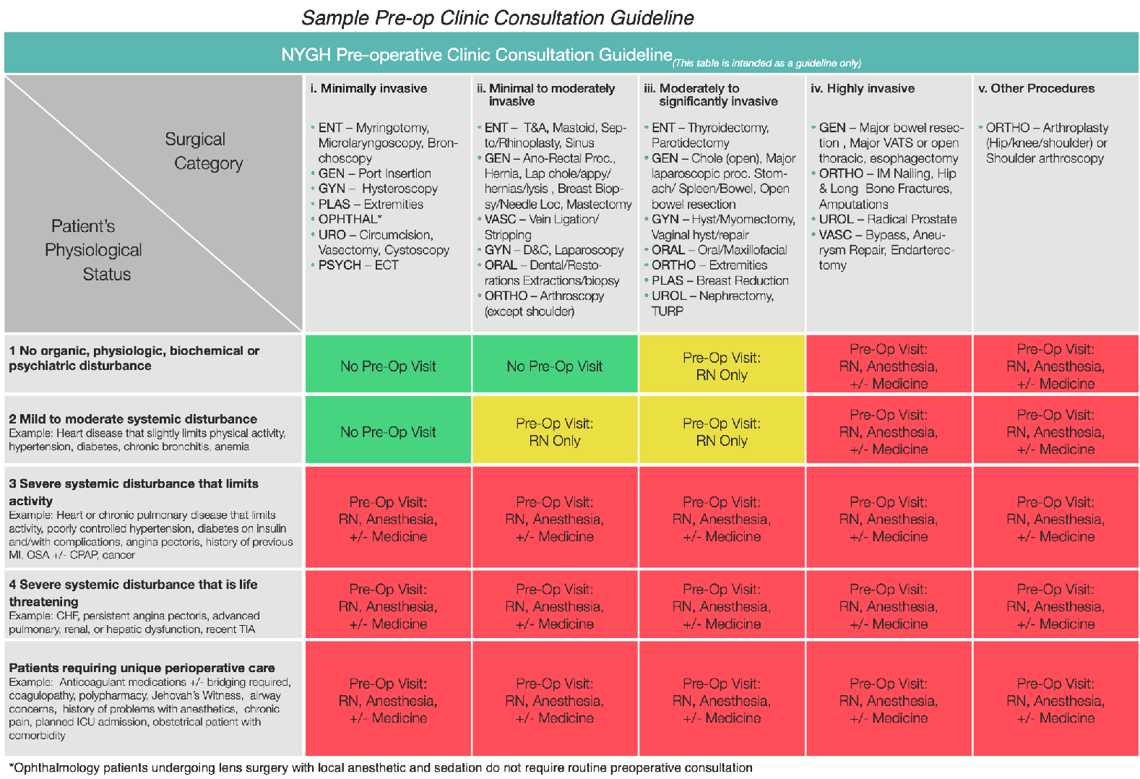
Sample Preop Consult Decision Guide

Slide 35
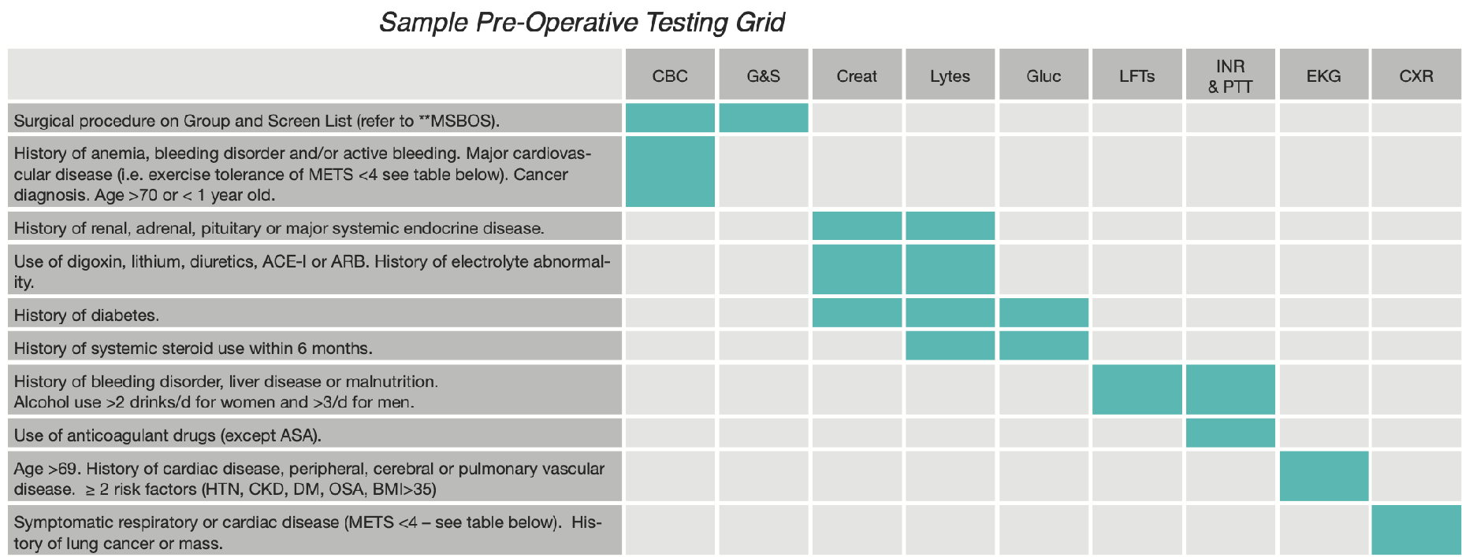
Sample Order Protocol

Slide 36
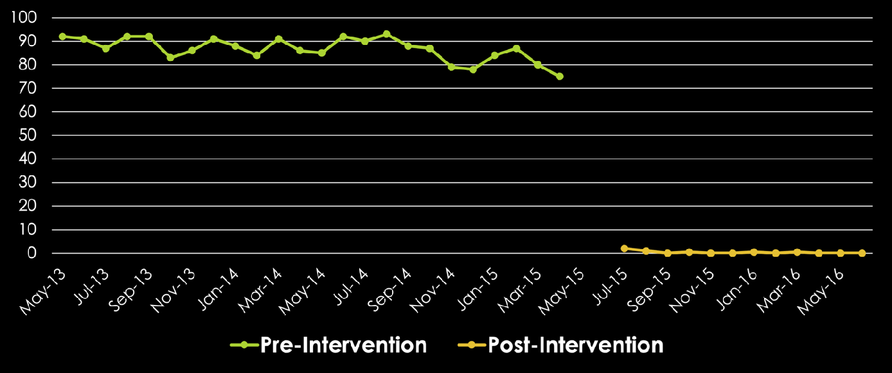
Order Standardization Intervention
Urine cultures performed after removal from preop order set (routine screening prior to elective joint arthroplasties)
Documentation of UTI symptoms required for testing
Lamb MJ et al. 2017. Elimination of Screening Urine Cultures Prior to Elective Joint Arthroplasty. Clin Infect Diseases. 64(6):806-809

Slide 37
Final Points
Resource stewardship is a professional and ethical obligation
Overuse is common, especially in learning environments
There is much potential for targeted interventions to result in successful, impactful change
Residents are uniquely positioned to question/challenge and decrease overuse and demonstrate/promote resource stewardship

Slide 38
For our upcoming session, think about various examples of waste (in anesthesia) that you have observed. What types of personal/system interventions would you suggest to make a difference?

Slide 39
The End!

Slide 40
This work is licensed under CC BY-NC-SA 4.0. To view a copy of this license, visit: https://creativecommons.org/licenses/by-nc-sa/4.0/

